Slide 1
CASE STUDY: LINUX
Shahina Anwarul
sanwarul@ddn.upes.ac.in

Slide 2

Linux
Linux is an operating system based on UNIX.
It was first introduced by Linus Torvalds.
It is based on the Linux Kernel, and can run on different hardware platforms manufactured by Intel, HP, IBM, SPARC and Motorola.
Another popular element in Linux is its mascot, a penguin figure named Tux.

Slide 3
Linux History
In 1990, Richard Stallman visited Polytechnic University in Helsinki, Finland to voice the philosophy of free software movement.
Among the audience was a 21 year old Linus Torvalds, future developer of Linux Kernel, liked the idea of sharing the code.
During 1991, Torvalds took the Minix operating system and rewrote it by adding features and released it as a first version of Linux.
During January 1992 Torvalds decided to adopt the GPL as a standard license for Linux. This was a major decision that Torvalds made.

Slide 4

Linux History
He chose it because it’s already proved by the community.
He knew that this will remove the restriction on charging for distribution costs, but it also invoked the GPL “viral” clause, which ensured that any new software built with Linux code would have to be released with source code under the GPL as well and would remain free code forever and no proprietary organizations can use it for their profit.
Torvalds became the chief architect of the Linux Kernel and now acts a project’s coordinator for Linux Kernel development.

Slide 5
Basic Components Of Linux
Just like any other typical operating system, Linux has all of these components:
kernel
Shells
GUIs
System utilities
Application program.
What makes Linux advantageous over other operating system is that every aspect comes with additional features and all codes for these are downloadable for free.

Slide 6
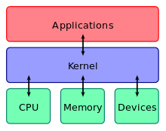
Kernel
Kernel is a computer program that constitutes the central core of a computer’s OS.
It has complete control over everything that occurs in the system.
Kernel connects the application software to the hardware of a computer.

Slide 7
Linux Shell
The shell is a program or it is an environment provided for user interaction.
The shell accepts human readable commands and translates them into something the kernel can read and process.
It is a command language interpreter that executes commands read from the standard input device such as keyboard or from a file.
The shell gets started when you log in or open a console (terminal).
The shell is not part of system kernel, but uses the system kernel to execute programs, create files etc.

Slide 8
Linux Shell
Several shells are available for Linux including:
BASH ( Bourne-Again SHell ) - Most common shell in Linux. It's Open Source.
CSH (C SHell) - The C shell's syntax and usage are very similar to the C programming language.
KSH (Korn SHell) - Created by David Korn at AT & T Bell Labs.
TCSH - It is an enhanced but completely compatible version of the Berkeley UNIX C shell (CSH).

Slide 9
Identify your shell
echo $SHELL

Slide 10
GUIs (Graphical User Interface)
Software that works at the point of contact (interface) between a computer and its user, and which employs graphic elements (dialog boxes, icons, menus, scroll bars) instead of text characters to let the user give commands to the computer or to manipulate what is on the screen.
KDE, GNOME, Xfce, Lxde are the GUIs for Linux.

Slide 11
System Utilities
Utility software is system software designed to help analyze, configure, optimize or maintain a computer.
Types of utilities:
Antivirus
Disk checkers
Disk cleaners
File manager
Network utilities, etc.

Slide 12
Application Program
An application program (sometimes shortened to application) is any program designed to perform a specific function.
Examples of application programs include word processors, database programs, Web browsers, drawing, paint, and image editing programs.

Slide 13
Linux Distribution
Linux quickly evolved from a single-person project to a world-wide development project involving thousands of developers.
One of the most important decisions for Linux was its adoption of the GNU General Public License (GPL).
This prohibited the misuse of the source code by the commercial vendors and nurtured the open source community for its rapid development.
A typical Linux distribution comprises of Linux kernel and many application programs and tools along with documentation

Slide 14
Linux Distribution
Both the Linux kernel and the GNU suite of applications are released under the GNU General Public License (GPL).
There are two categories of distributions:
Commercially backed – Fedora (Red Hat), openSUSE(Novell), Ubuntu(Canonical Ltd.) and Mandriva Linux(Mandriva)
Community driven – Debian and Gentoo

Slide 15
Linux Distribution
Community-based distributions like Debian, Gentoo, or CentOS are maintained largely by volunteers and donations of services or money.
While commercial distributions like Suse, Red Hat, or Xandros are backed by a company and compete directly against proprietary operating systems such as Windows and OS X.

Slide 16
Various Linux Distributions (Some Examples)
RPM Based
Fedora Based
EduLinux
RHEL Based
CentOS
ClearOS
Miracle Linux
Berry Linux
openSuse Based
Linkat
SUSE Desktop
SUSE Server
Debian Based
Knoppix Based
Feather Linux
Damn Small Linux
Ubuntu Based
Ubuntu GNOME
Ubuntu MATE
Lubuntu
Xubuntu
PacMan Based
Chakra Linux
Arch Based
ArchBang
Manjaro
Antergos
Gentoo Based
Gentoox
Ututo
CoreOS
Funtoo

Slide 17
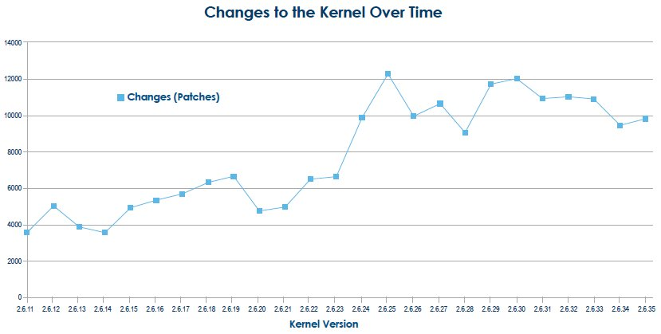
Change Rate
The Linux kernel which forms the core of the Linux operating system is a result of contributions from over 1000 developers and 200 corporations.
The rate of change in the kernel is increasing rapidly.
On an average there are 4 to 5 patches applied to the kernel tree per hour.
when a new kernel is released, defects will be reported and patches will be released that contains the fix for the problem.

Slide 18
Kernel Development
There are over 1000 developers and 200 corporations who are sponsoring the work of the Linux kernel development with the significant contributions being made from the individual developer community.
The Pareto principle, well known as the 80-20 rule is applicable to the contributions made by developer community.
The snapshot shows the top 10 contributors making 70% of the total changes to the kernel

Slide 19
Kernel Development
The “None” category represent individuals that are doing the kernel development work on their own interest without the financial benefit from any organization.
The “Unknown” category represents developers whose corporate affiliation cannot be determined.

Slide 20
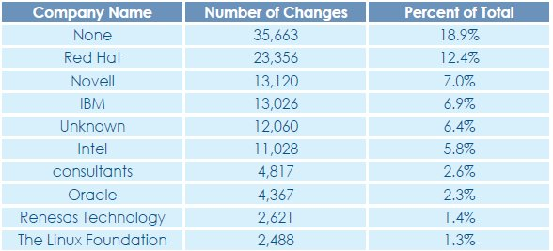
Kernel Development

Slide 21
Linux Dominance in the Industry
The Linux operating system is one of the largest and most successful open source projects that has proven open source development model is effective.
The large number of developers contributing towards the improvement of Linux and the rate at which changes are incorporated is remarkable in the technological realm.
Linux is no more limited to being a desktop operating system.

Slide 22
Linux Dominance in the Industry
It has made its way to the production environment across multiple industry verticals like Chemical and Petroleum, Education, Finance and so on.
The data (shown below) from Top500.org which shows the dominance of Linux in the Super Computing industry.

Slide 23
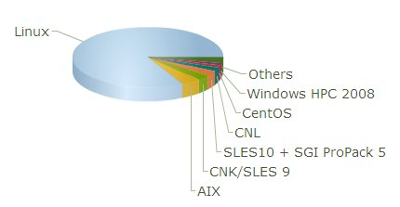
Linux Dominance in the Industry
June 2011
Results

Slide 24
Difference Between Linux And Unix
Unix originally began as a proprietary operating system from Bell Laboratories, which later on spawned into different commercial versions.
On the other hand, Linux is free, open source and intended as a non-proprietary operating system for the masses.

Slide 25
Difference Between Linux And Unix
License & Cost
Linux is Free. You can download it from the Internet or redistribute it under GNU licenses. You will see the best community support for Linux. Most UNIX like operating systems are not free (but this is changing fast, for example OpenSolaris UNIX).
Security Firewall Software
Linux comes with open source netfilter/iptables based firewall tool to protect your server and desktop from the crackers and hackers. UNIX operating systems comes with its own firewall product (for example Solaris UNIX comes with ipfilter based firewall) or you need to purchase a 3rd party software such as Checkpoint UNIX firewall.

Slide 26
Difference Between Linux And Unix
File Systems
Linux by default supports and use ext3 or ext4 file systems.
UNIX comes with various file systems such as jfs, gpfs (AIX), jfs, gpfs (HP-UX), jfs, gpfs (Solaris).
UNIX Operating System Names
HP-UX
IBM AIX
Sun Solairs
Mac OS X
IRIX

Slide 27
Difference Between Linux And Unix
Linux Distribution (Operating System) Names
Redhat Enterprise Linux
Fedora Linux
Debian Linux
Suse Enterprise Linux
Ubuntu Linux

Slide 28
Common Things Between Linux & UNIX
Both share many common applications such as:
GUI (KDE, Gnome)
Shells (ksh, csh, bash)
Various office applications such as OpenOffice.org
Development tools (GNU c/c++ compilers)

Slide 29
To Change Permissions
Assuming you are the system administrator or the owner of a file or directory, you can grant permission using the chmod command.
Use + symbol to add permission or – symbol to deny permission, along with any of the following letters: u (user), g (group), o (others), a (all), r (read), w (write) and x (execute).
For example the command chmod go+rw FILE1.TXT grants read and write access to the file FILE1.TXT, which is assigned to groups and others.

Slide 30
To Change Permissions
chmod – change file access permissions chmod 744 file.c
chmod 700 apple.txt | Only you can read, write to, or execute apple.txt
chmod 777 apple.txt | Everybody can read, write to, or execute apple.txt
chmod 744 apple.txt | Only you can read, write to, or execute apple.txt Everybody can read apple.txt;
chmod 444 apple.txt | You can only read apple.txt, as everyone else.

Slide 31
Shell Script
A shell script is a file that contains a sequence of commands for a UNIX-based operating system.
It's called a shell script because it combines into a "script" in a single file a sequence of commands that would otherwise have to be presented to the system from a keyboard one at a time.
The shell is the operating system's command interpreter.
A shell script is usually created for command sequences for which a user has a repeated need.

Slide 32
Writing and Executing Shell Script
Open the text editor and write the script
#!/bin/bash
# My first script
echo "Hello World!"
The first line of the script is important. This is a special clue given to the shell indicating what program is used to interpret the script. In this case, it is /bin/bash.
The second line is a comment.
The last line is the echo command. This command simply prints what it is given on the display.

Slide 33
To Make Shell Script Executable
Using the chmod command we can make a shell script executable.
Example is shown below :
chmod a+x myscript.sh
or
chmod 444 myscript.sh
To run the script
./myscript.sh

Slide 34
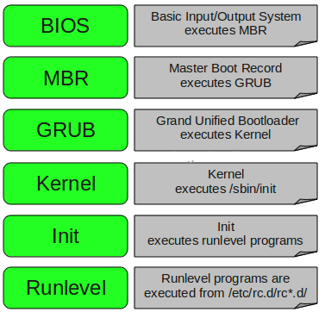
Linux Booting

Slide 35
Linux Booting (in Detail)
1. BIOS
BIOS stands for Basic Input/Output System
Searches, loads, and executes the boot loader program.
It looks for boot loader in floppy, cd-rom, or hard drive. You can press a key (typically F12 of F2, but it depends on your system) during the BIOS startup to change the boot sequence.
Once the boot loader program is detected and loaded into the memory, BIOS gives the control to it.
So, in simple terms BIOS loads and executes the MBR boot loader.

Slide 36
Linux Booting (in Detail)
2. MBR
MBR stands for Master Boot Record.
It is located in the 1st sector of the bootable disk. Typically /dev/hda, or /dev/sda
MBR is less than 512 bytes in size. This has three components 1) primary boot loader info in 1st 446 bytes 2) partition table info in next 64 bytes 3) MBR validation check in last 2 bytes.
It contains information about GRUB (or LILO in old systems).
So, in simple terms MBR loads and executes the GRUB boot loader.

Slide 37
Linux Booting (in Detail)
3. GRUB
GRUB stands for Grand Unified Bootloader.
If you have multiple kernel images installed on your system, you can choose which one to be executed.
GRUB displays a splash screen, waits for few seconds, if you don’t enter anything, it loads the default kernel image as specified in the grub configuration file.
Grub configuration file is /boot/grub/grub.conf.
So, in simple terms GRUB just loads and executes Kernel and initrd (initial RAM Disk) images.

Slide 38
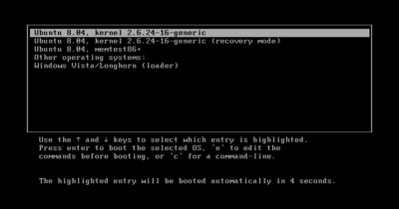
GRUB

Slide 39
Linux Booting (in Detail)
4. Kernel
Mounts the root file system as specified in the “root=” in grub.conf
Kernel executes the /sbin/init program
Since init was the 1st program to be executed by Linux Kernel, it has the process id (PID) of 1. Do a ‘ps -ef | grep init’ and check the pid.
initrd stands for Initial RAM Disk.
initrd is used by kernel as temporary root file system until kernel is booted and the real root file system is mounted.

Slide 40
Linux Booting (in Detail)
5. Init
Looks at the /etc/inittab file to decide the Linux run level.
Following are the available run levels
0 – halt
1 – Single user mode (for administrative purpose)
2 – Multiuser, without NFS (used rarely)
3 – Full multiuser mode, command line (used by servers)
4 – unused
5 – multiple users, GUI, (the standard runlevel)
6 – reboot
Init identifies the default runlevel from /etc/inittab and uses that to load all appropriate program.
Execute ‘grep initdefault /etc/inittab’ on your system to identify the default run level
If you want to get into trouble, you can set the default run level to 0 or 6. Since you know what 0 and 6 means, probably you might not do that.
Typically you would set the default run level to either 3 or 5.

Slide 41
Linux Booting (in Detail)
6. Runlevel programs
When the Linux system is booting up, you might see various services getting started. For example, it might say “starting sendmail …. OK”. Those are the runlevel programs, executed from the run level directory as defined by your run level.
Depending on your default runlevel setting, the system will execute the programs from one of the following directories.
Run level 0 – /etc/rc.d/rc0.d/
Run level 1 – /etc/rc.d/rc1.d/
Run level 2 – /etc/rc.d/rc2.d/
Run level 3 – /etc/rc.d/rc3.d/
Run level 4 – /etc/rc.d/rc4.d/
Run level 5 – /etc/rc.d/rc5.d/
Run level 6 – /etc/rc.d/rc6.d/

Slide 42
Building The Linux Kernel
Configuring the Kernel
Compiling the Kernel
Installing the Kernel
Clean Linux Source and Config file

Slide 43
Linux Installation – Minimum Requirements
Minimum Requirements for common Linux distributions:
700 MHz processor (about Intel Celeron or better)
512 MB RAM (system memory)
5 GB of hard-drive space
Either a CD/DVD drive or a USB port for the installer media
Internet access is helpful

Slide 44
OS X Lion- Minimum Requirements
Minimum Requirements for OS X Lion:
An Intel Core 2 Duo, Core i3, Core i5, Core i7, or Xeon processor
7 GB of available disk space
2 GB of RAM
Either a CD/DVD drive or a USB port for the installer media

Slide 45
Mac OS X v10.6 Snow Leopard- Minimum Requirements
Install Snow Leopard for the first time, you must have a Mac with:
An Intel processor
At least 1 GB of RAM (additional RAM is recommended)
At least 5 GB to 7 GB of disk space available
Either a CD/DVD drive or a USB port for the installer media

Slide 46
Windows 7
If you want to run Windows 7 on your PC, here's what it takes:
1 gigahertz (GHz) or faster 32-bit (x86) or 64-bit (x64) processor
1 gigabyte (GB) RAM (32-bit) or 2 GB RAM (64-bit)
16 GB available hard disk space (32-bit) or 20 GB (64-bit)
DirectX 9 graphics device with WDDM 1.0 or higher driver
Internet access is helpful

Slide 47
Windows 10
1 gigahertz (GHz) or faster processor
1 gigabyte (GB) for 32-bit or 2 GB for 64-bit
16 GB for 32-bit OS 20 GB for 64-bit OS
DirectX 9 or later with WDDM 1.0 driver
Internet access is helpful

Slide 48
Difference Between BASH And DOS
BASH commands are case sensitive while DOS commands are not.
Under BASH, / character is a directory separator and \ acts as an escape character. Under DOS, / serves as a command argument delimiter and \ is the directory separator.
DOS follows a convention in naming files, which is 8 character file name followed by a dot and 3 character for the extension while BASH follows no such convention.

Slide 49
Linux Installation – Partitioning
For a healthy Linux installation, three partitions are recommended:
swap
This is space on the hard drive that can be used as virtual memory. Virtual memory allows computer to run large programs and perform complex tasks even if it does not have enough physical RAM to do the job.
One swap partition is usually 50% to 100% the size of the physical RAM in your system
root (/)
The root file system is represented by a forward slash (/). It is the top of the directory tree, and contains Linux and everything that you install with Linux.
This is roughly equivalent to “C:”
Usually a minimum root partition is between 2GB and 8GB.
/home
The place where all the user-specific files, data in other words, are stored.
It is roughly equivalent to the “My Documents” folder

Slide 50
What is Disk Partitioning?
Disk partitioning or disk slicing is the creation of one or more regions on a hard disk or other secondary storage, so that an operating system can manage information in each region separately.
Partitioning is typically the first step of preparing a newly manufactured disk, before any files or directories have been created.
The disk stores the information about the partitions' locations and sizes in an area known as the partition table that the operating system reads before any other part of the disk.
Each partition then appears in the operating system as a distinct "logical" disk that uses part of the actual disk.
System administrators use a program called a partition editor to create, resize, delete, and manipulate the partitions.

Slide 51
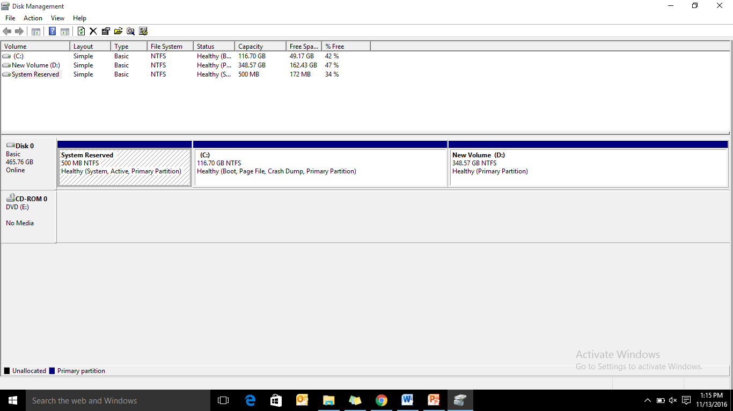
Disk Partitioning

Slide 52
Benefits Of Multiple Partitions
Separation of the operating system (OS) and program files from user files.
Protecting or isolating files, to make it easier to recover a corrupted file system or operating system installation. If one partition is corrupted, other may not be affected.
Use of multi-boot setups, which allow users to have more than one operating system on a single computer. For example, one could install Linux, BSD, Mac OS, Microsoft Windows or other operating systems on different partitions of the same HDD and have a choice of booting into any compatible operating system at power-up.

Slide 53
Disadvantages Of Multiple Partitions
Reduces the total space available for user storage on the disk, as it forces the operating system to duplicate certain file system administration areas on the disk for each partition.
Increases disk fragmentation because it lowers the average size of contiguous free blocks on each partition – as compared to a single partition of the same overall size – after the same amount of data has been written to them.

Slide 54
Disadvantages Of Multiple Partitions
May prevent using the whole disk capacity, because it may break free capacities apart.
For example, if one has a disk with two partitions, each with 3 GB free (hence 6 GB in total), one can't copy a 4 GB DVD image file on that disk, because none of the partitions will actually provide enough space for that even though there is more than enough free capacity in total on the disk. If the same files on those two partitions would have been stored on a single partition spanning the whole disk, then the 4 GB file could be easily stored in the 6 GB of free space.

Slide 55
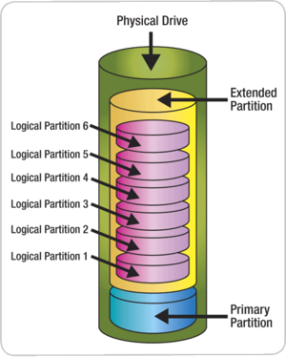
Partition Types

Slide 56
Primary Partition
A primary partition contains one file system.
In DOS and all early versions of Microsoft Windows systems, Microsoft required what it called the system partition to be the first partition.
All Windows operating systems from Windows 95 onwards can be located on (almost) any partition, but the boot files (io.sys, bootmgr, ntldr, etc.) must reside on a primary partition.

Slide 57
Extended Partition
An HDD may contain only one extended partition, but that extended partition can be subdivided into multiple logical partitions.
DOS/Windows systems may then assign a unique drive letter to each logical partition.

Slide 58
Partitioning Schemes
DOS, Windows, and OS/2
Unix-like systems
Multi-boot and mixed-boot systems
GUID Partition Table

Slide 59
DOS, Windows, and OS/2
With DOS, Microsoft Windows, and OS/2, a common practice is to use one primary partition for the active file system that will contain the operating system, all utilities, applications, and other files.
On most Windows consumer computers, the drive letter C: is routinely assigned to this primary partition.
Other partitions may exist on the HDD that may or may not be visible as drives, such as recovery partitions.
Microsoft Windows 2000, XP, Vista, and Windows 7 include a 'Disk Management' program which allows for the creation, deletion and resizing of FAT and NTFS partitions.

Slide 60
Unix-like systems
On Unix-based and Unix-like operating systems such as Linux, macOS, BSD, and Solaris, it is possible to use multiple partitions on a disk device.
Each partition can be formatted with a file system or as a swap partition.
Multiple partitions allow directories such as /boot, /tmp, /usr, /var, or /home to be allocated their own filesystems.
Such a scheme has a number of advantages:
If one file system gets corrupted, the data outside that filesystem/partition may stay intact, minimizing data loss.
Specific file systems can be mounted with different parameters e.g. read-only.

Slide 61
Unix-like systems
A common configuration for Linux desktop systems is to use two partitions: one holding a file system mounted on "/" (the root directory) and a swap partition.
In Solaris, partitions are sometimes known as slices. This is a conceptual reference to the slicing of a cake into several pieces.

Slide 62
Multi-boot and mixed-boot systems
Multi-boot systems are computers where the user can boot into one of two or more distinct operating systems (OS) stored in separate storage devices or in separate partitions of the same storage device.
In such systems a menu at startup gives a choice of which OS to boot/start (and only one OS at a time is loaded).
This is distinct from virtual operating systems, in which one operating system is run as a self-contained virtual "program" within another already-running operating system. (An example is a Windows OS "virtual machine" running from within a Linux OS)

Slide 63
Multi-boot and mixed-boot systems

Slide 64
GUID Partition Table
The GUID Partition Table (Globally Unique IDentifier) is a standard for the layout of the partition table on a physical hard disk using Globally Unique IDentifiers.
Many operating systems now support this standard.

Slide 65
Linux Installation – Common Problems
Use of bad ISO
Network Adapter settings in VM while installing Linux in VM
Allocating less than 50% memory to swap partition
Incomplete knowledge about Linux Partitions
Forgetting to update the list of available packages
Resizing of a Windows partition to accommodate Linux for parallel installation

Slide 66
Multiple Desktop Environments Installed Will Be Beneficial or Not?
In general, one desktop environment, like KDE or Gnome, is good enough to operate without issues. It’s all a matter of preference for the user, although the system allows switching from one environment to another. Some programs will work on one environment and not work on the other, so it could also be considered a factor in selecting which environment to use.

Slide 67
Questions
What is Kernel Command Line? Write 5 Kernel command line arguments.
https://www.freedesktop.org/software/systemd/man/kernel-command-line.html
How to create your own Init script on any Linux distribution? Create one Init script using command line.
https://www.linux.com/learn/managing-linux-daemons-init-scripts

